Slide 1
Public Forum Debate
Mr. Machado

Slide 2
The Topic
Topics are worded as Resolutions, meaning they advocate solving a problem by establishing a position.
Instead of Affirmative or Negative, teams are referred to as Pro or Con.
Each team is expected to prepare arguments for both Pro and Con.

Slide 3
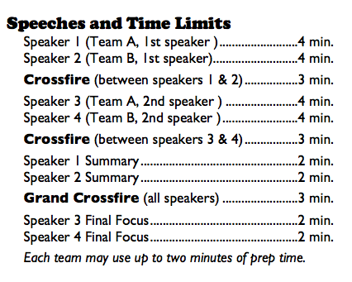
PF Debate Format

Slide 4
1st Pro speech
4 Minutes
An underlying concept will always be the risk of change versus the risk of not changing
This speech should have a brief introduction to frame the team’s case for the judge
If a definition is important to understanding the case
A few reasons for adopting the topic should be presented with accompanying evidence.

Slide 5
1st Con Speech
4 Minutes
This speech constructs arguments showing disadvantages of the resolution and why it should not be adopted.
If the pro speech has the advantage of a changing future, the con speech has a track record of experience (status quo) and why change is ill-advised
The rest of the speech elements will be the same as the pro speech

Slide 6
Cross-fire
3 Minutes
Involving the Pro and Con speakers, each debater is allowed to ask each other questions about the topic
Usually, the debaters will stand in the front of the room during this time and face the judge
Forcing an opponent to contradict himself is a winning move
It is a bad idea to pursue any single point too long in the crossfire

Slide 7
2nd speakers – pro & con speech
4 Minutes
The debaters should identify the opposition’s key arguments and attack their legitimacy by:
turning the analysis to the other side;
presenting evidence that destroys or reduces the opposing position;
presenting alternate causes that are not accounted for by the opposition argument;
exposing argument inconsistencies between the speakers or between the opponents and their statements during crossfire.

Slide 8
summary Speeches
2 Minutes
New evidence, but not new arguments may be presented
This means that a limited number of issues can be addressed
For example, perhaps develop one to two issues from the debater’s side on the resolution and one from the opponent’s side of the resolution
On each key argument, try to add a short original quotation, anecdote, or fact

Slide 9
Grand cross-fire
3 Minutes
Involving all four debaters, debaters are allowed to ask each other questions about the topic
The first question is asked to the team that just ended its summary by the other team
Debaters will usually remain seated during this time
Resist rushing questions or answers, or trying to do too much in crossfire; desperation is not persuasive.

Slide 10
final focus speeches
2 Minutes
This frames, with clarity, why your team has won the debate
Again, no new arguments may be presented, however, new evidence may be introduced to support an argument made earlier in the debate
Strategies may include:
Choose the most important argument you are winning
Choose an argument that you believe the judge will most likely vote on
Expose a major inconsistency made by your opponent

Slide 11
Prep time
Each team has two minutes of prep time.
For very practical reasons, a team should not use prep time until their summary speech or final focus speech
Being prepared on the arguments is the best way to avoid using prep time until it is vital to select the key arguments and issues

Slide 12
Helpful pf debate tips
A debater who attempts to dominate or be rude to his opponent will lose points
The best cases are closely reasoned. You should keep track or your contentions and your opponents, referring to them as first, second, and third, for example.
Point out that certain arguments you have made have not really been refuted by the opponents, if that is the case
As soon as you have answered, ask a question. Otherwise you will be whooped up on like a defendant in court.

Slide 13
You need fully-prepared first speeches for both pro and con. Debaters often read these speeches from prepared script/outline.
The second speakers, who speak after the first cross-examination/crossfire is over, have two basic jobs:
strengthen your side’s case by adding arguments and evidence, and
attacking the opponent’s case by refuting (rebutting) their arguments and evidence

